Slide 1

Research and Analysis for Vulnerability of Zigbee Communication
JinHyuck Park
Juyeon Kang
Sangheon Lee
Security Engineering
Notes:
Good morning
My name is Juyeon kang and our team members are saheon lee and jinhyuck park
Let me begin with presentation about research and analysis for

Slide 2
Content
Motivation
Background on Zigbee Network
Zigbee Security Protocol
Analysis and Evaluation
Demonstration
Conclusion
Notes:
The presentation are in the following order.

Slide 3



Motivation
Smart power grid was threaten by Hacker
Power Plant
Hacker
Notes:
First of all, Our motivation

Slide 4
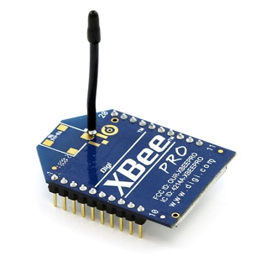
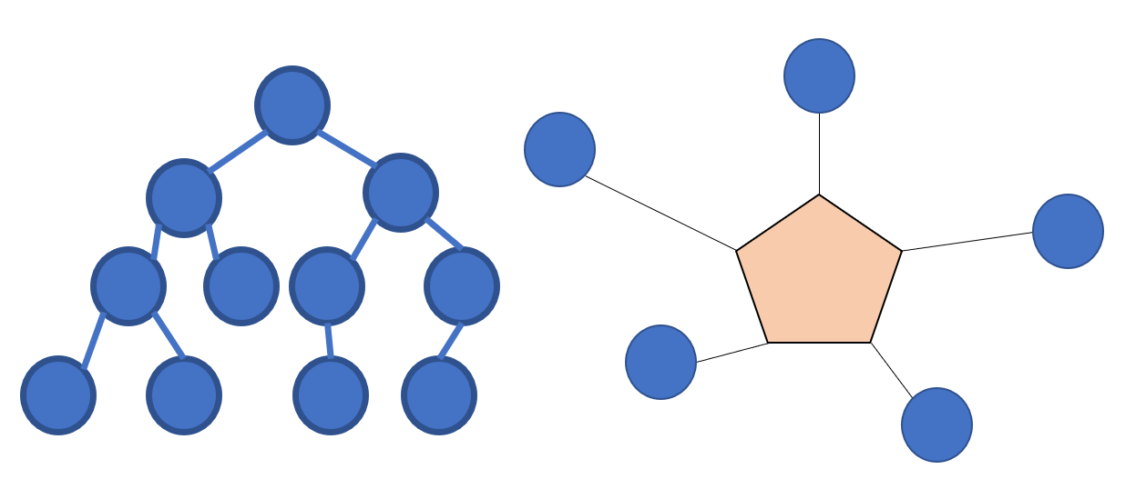
Background on Zigbee
What is Zigbee?
IEEE 802.15.4 based specification
Use 16 channels and Create personal area networks.
Ad hoc network.
Low power digital radios.
Home automation, Medical device date Collection.
However
Because of Low power, it has low date rate.
Limited distance about 100 meters line-of-sight.
Network structure of Zigbee(Tree, Star)

Slide 5
Zigbee Security Protocol
Open Trust Model
Zigbee Encryption
Guarantees reliability between all layers and all programs in each device.
Each device guarantees only its own reliability
So it cannot know what encryption process the other device is going through
However, threating in the transmission process to the outside
Zigbee uses the 128-bit symmetric key block cipher(AES-128)
CCM algorithm is used for encryption and authentication.

Slide 6
Zigbee Key Exchange Process
Kind of Key | Role
MK (Master Key) | Symmetric key for link key generation
LK (Link Key) | Encrypt the message between two devices
NK (Network Key) | Shared by all device in same network Basically, not encrypted in Standard Security
 | MK | LK | NK
Key-Transport | ○ | ○ | ○
Key-Establishment | Ⅹ | ○ | Ⅹ
Pre-installation | ○ | ○ | ○

Slide 7
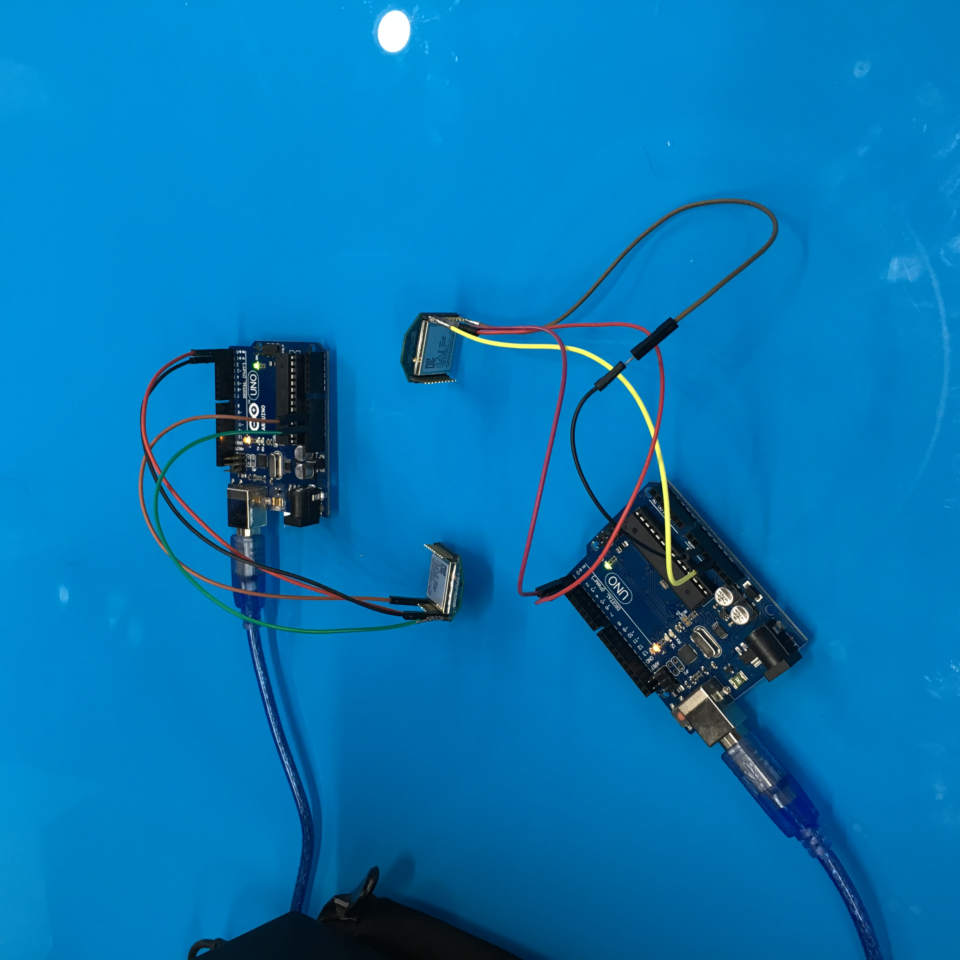
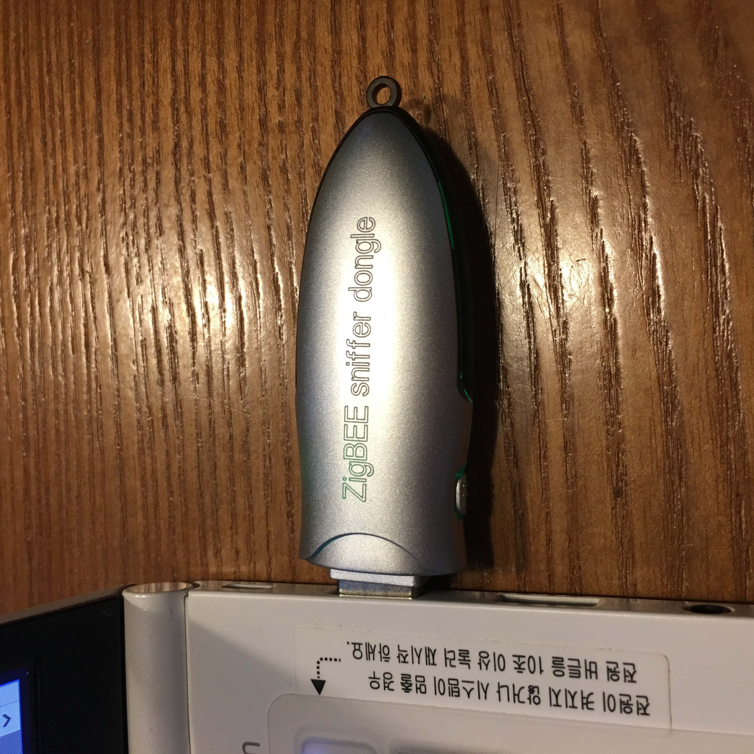
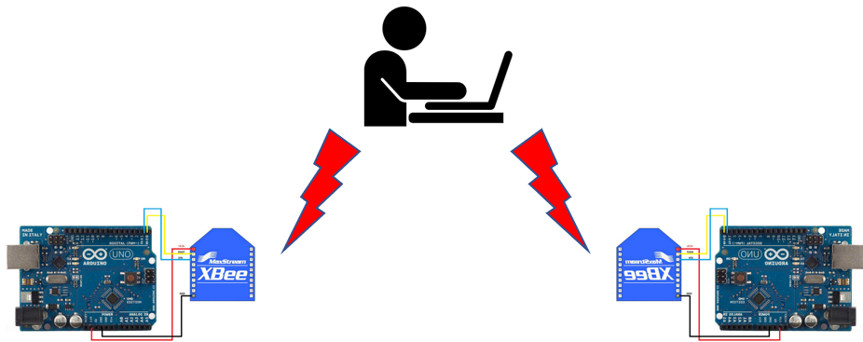
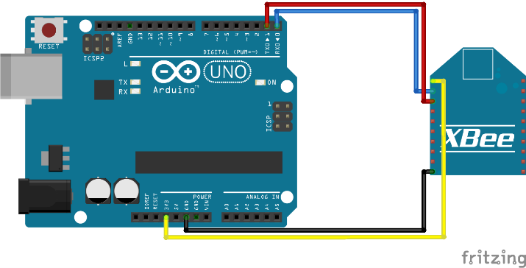
Experiment

Slide 8

Experiment
Configure the experimental environment(Hardware).
Using Xctu, setting the address and channel of Sender & Receiver.
PAN ID
Channel
Destination High and Low Address = Source High and Low Address
Open Serial Monitor of each point.
Typing word and Sending
Sniffer catch the packet between Sender and Receiver
Analysis Packet.

Slide 9
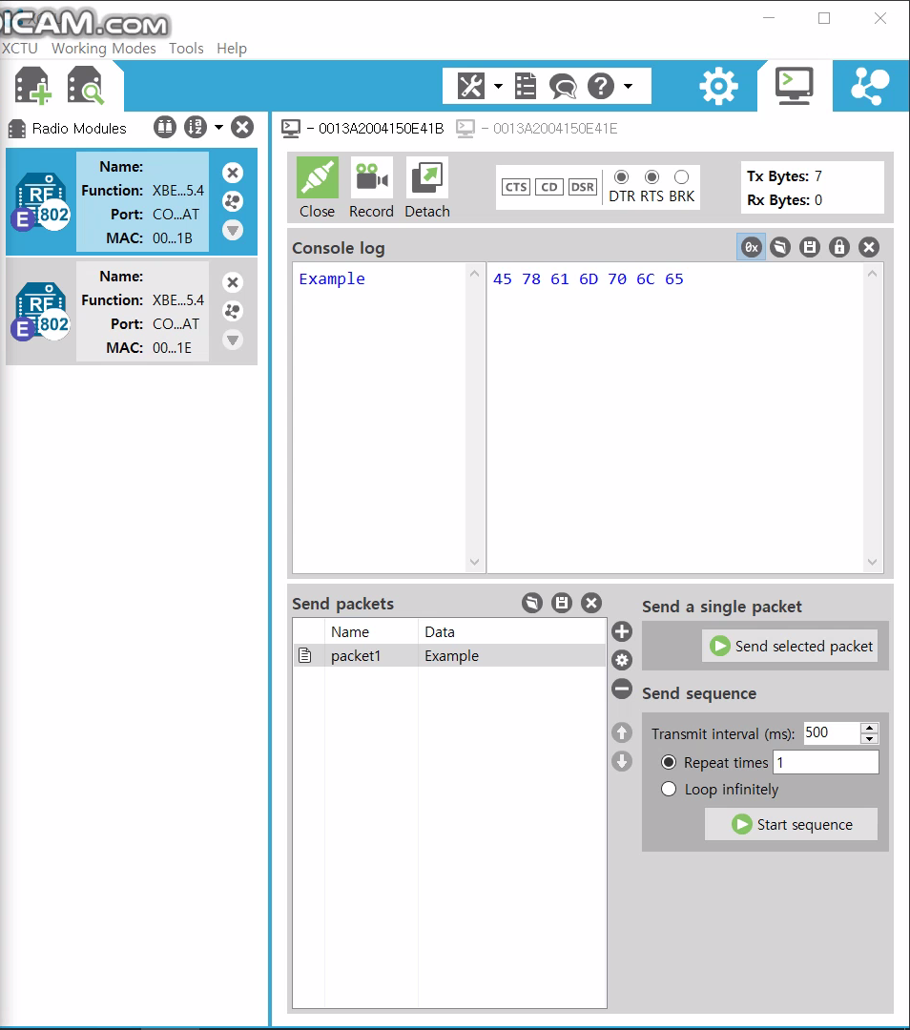
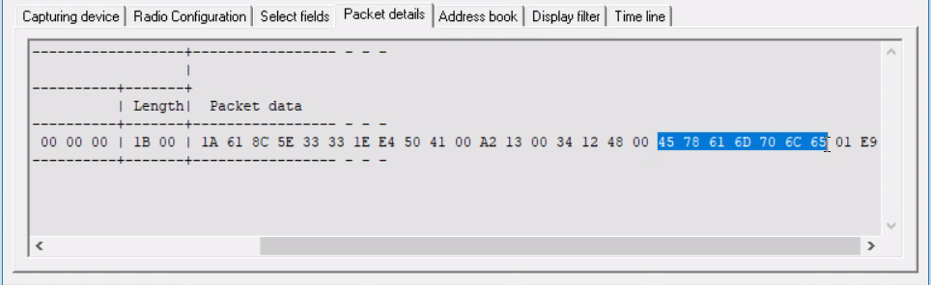
Result and Analysis

Slide 10

Demonstration

Slide 11

Conclusion
Zigbee is used in various Field
Smart power grid
Home Automation
Commercial Building Automation
Telecommunication Application
Personal, Home, and Hospital Care and so on.
Low power consumption and cost
However, Need more powerful Security protocol.
With low power operation.

Slide 12
Thank you For your attention!
JinHyuck Park
JuYeon Kang
SangHeon Lee
Security Engineering

